Slide 1
REALESTATE MANAGEMENT SYSTEM
MINI PROJECT

Slide 2
ABSTRACT
Real Estate Management System – is an Estate Agent and Property Management System is a user friendly contact and property manager for real estate .
This website is a Online real estate business website through which a user can access its information and manage all the adding, updating, deleting the assets and some of its tasks.
The basic objective of developing this project is:
• Maintain client details line contact details, required property details, client type like residential and commercial client. Price limit. Preference.
• Maintain property details, registration of property for sale includes property address, property description, price, facilities available. Store property floor plan, property documents. Creation of thumbnail of property images for brochure.
• System has powerful logical access management in place, each user must be identified by login id and strict password policy is applied to secure the system

Slide 3
The Admin user can change the update the information regarding property selling and buying and cancellation. The system is very useful for the companies who developed apartments, hotels, villa, residential properties and commercial properties. Companies or individual agents can also advertise their property.
idea behind developing this application is that their property can also sell, or buy property usingthis website .
The system is very useful for the companies or builders that can post their properties and their personal info and admin can monitor records of all of them. The system is also useful which also keeps track of Account details of buyers and Investors.

Slide 4
MODULES
Real Estate Management System is my mini project which provides the facility where users can easily buy, sale their properties such as land, houses and shops. In this project we use PHP and MySQL database. It has two modules.
Admin Module
Broker

Slide 5
Admin
1. Dashboard: In this section, admin can see all detail in brief like total property type, total country, total state, total city, total agent, total owner, total buyer(user) ant total property listed.
2. Property Type: In this section, admin can manage property type (add/update).
3. Country: In this section, admin can manage country (add/update).
4. State: In this section, admin can manage state (add/update).
5. City: In this section, admin can manage city (add/update).
6. Owner: In this section, admin can view the detail of owners.

Slide 6
7. Agents: In this section, admin can view the detail of agents.
8. User: In this section, admin can view the detail of user.
10. Pages: In this section, admin can manage about us and contact us pages..
Admin can also update his profile, change the password.

Slide 7
Broker
1. Home Page: Owner can view the home page of real estate management system
2. Properties: Owner can view own and other owner properties they can view property type wiseand city wise.
3. Contact us: Owner can view contact us page.
. 4. My Account: In this there is three section:
a. User Profile
i. Edit Profile: Owner can edit his/her own profile.
Ii. Add Property: Owner can add his/her own property.

Slide 8
v. Received Enquiries: Owner can view receive enquiries against his/her own listed properties and also answer the enquiries.
vi. Logout: Owner can logout from own account.

Slide 9
TABLE DESIGN
TBL_USERS
Field | Datatype | Constraints
ID | int | Primary key
Full_name | Varchar(100) | NOT NULL
Address | Varchar(500) | NOT NULL
Mob no | Int(10) | NOT NULL
Status | Varchar(20) | NOT NULL
emailid | Varchar(10) | NOT NULL

Slide 10
Tbicountry
Field | Datatype | Constraints
CID | int | Primary key
CountryName | Varchar(100) | NULL

Slide 11
Tblstate
Field | Datatype | Constraints
SID | int | Primary key
CID | int | Foreignkey
StateName | Varchar(100) | NULL

Slide 12
Tblcity
Field | Datatype | Constraints
DID | int | Primary key
CID | Int | Foreign key
SID | Int | Foreign key
CityName | Varchar(100) | NULL

Slide 13
Tblpropertytype
Field | Datatype | Constraints
PID | int | Primary key
PropertyType | Varchar(100) | NULL

Slide 14
Tblproperty
Field | Datatype | Constraints
ID | int | Primary key
PID | int | Foreign key
UserId | int | Foreign key
Property title | Varchar(100) | NULL
PropertyDescription | Varchar(100) | NULL
PropertyType | Varchar(50) | Foreign key
Status | Varchar(100) | NULL
Location | Varchar(200) | NULL
Area | Varchar(50) | NULL
Size | Varchar(50) | NULL
SalePrice | Varchar(20) | NULL
IMG_ID | Varchar(200) | Foreign key
Address | Varchar(200) | NULL
Country | Varchar(200) | Foreign key
State | Varchar(200) | Foreign key
District | Varchar(200 | Foreign key

Slide 15
Tblenquiry
Field | Datatype | Constraints
EID | int | Primary key
PID | Int | Foreign key
UID | int | Foreign key
Message | Varchar(500) | NOTNULL
EnquiryDate | timestamp | NOTNULL
Status | Varchar(100) | NULL
Remark | Varchar(200) | NULL
RemarkDate | timestamp | NULL

Slide 16
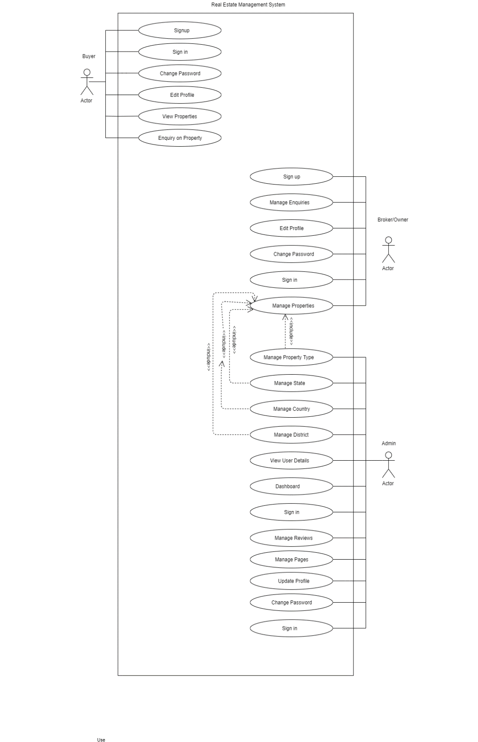
1 USE CASE DIAGRAM

Slide 17
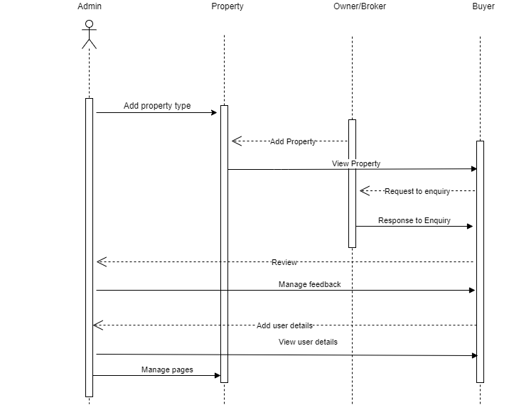
2 .SEQUENCE DIAGRAM

Slide 18
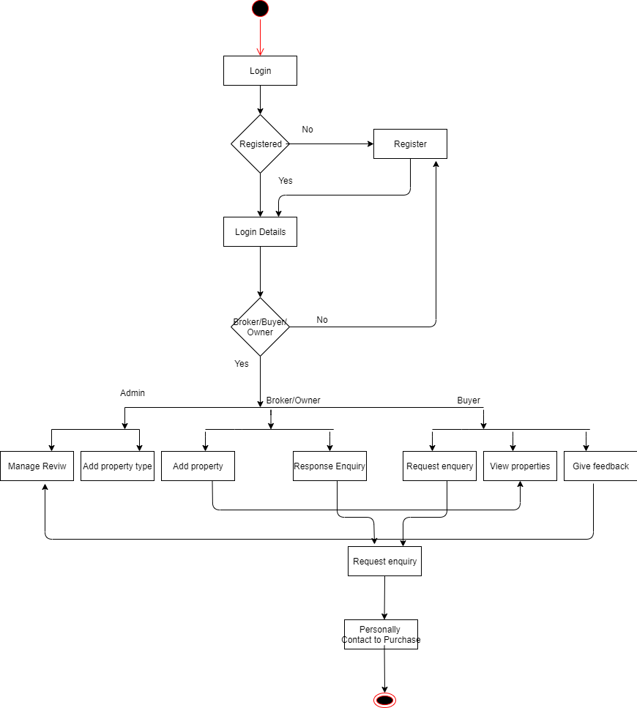
3 ACTIVITY DIAGRAM

Slide 19
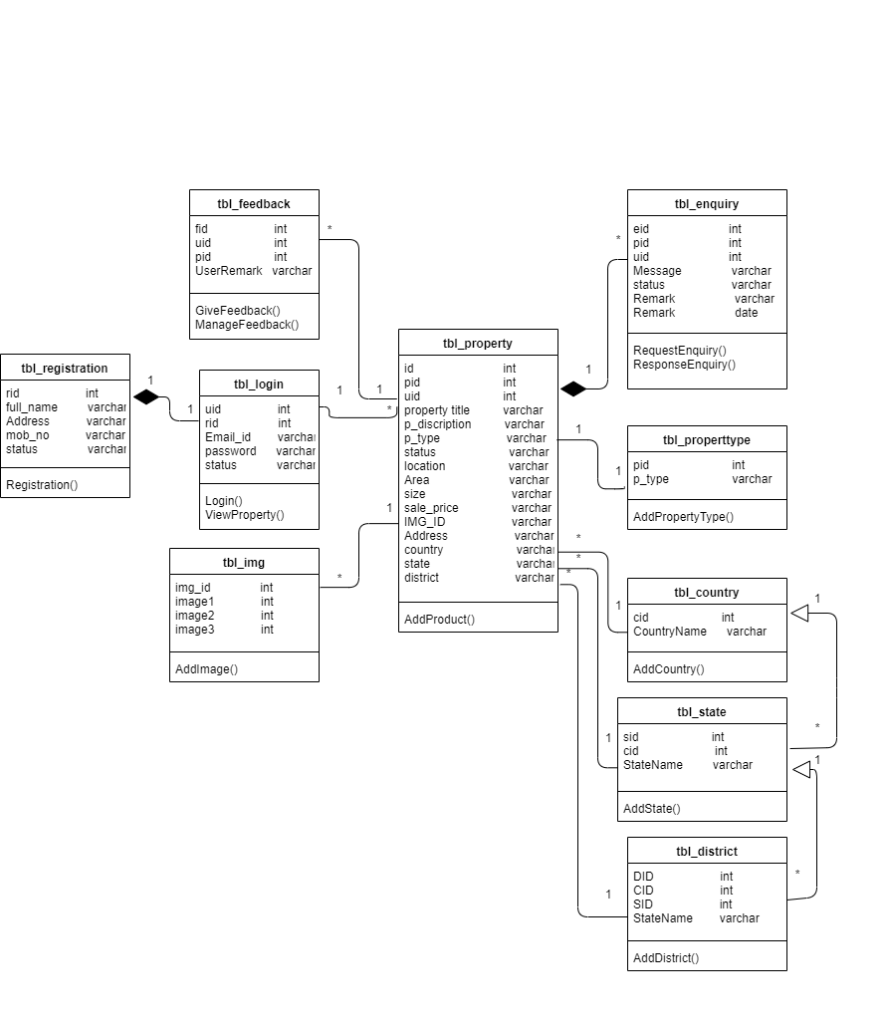
4 CLASS DIAGRAM

Slide 20
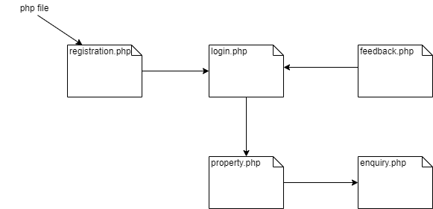
5 COMPONENT DIAGRAM

Slide 21
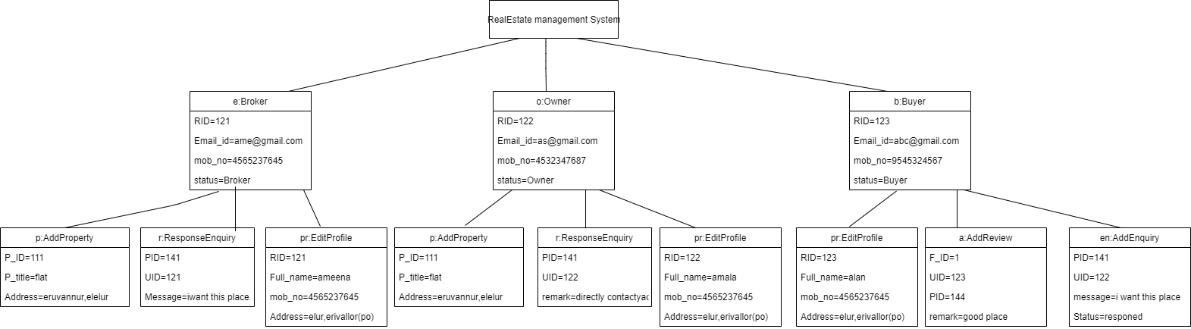
6.OBJECT DIAGRAM

Slide 22
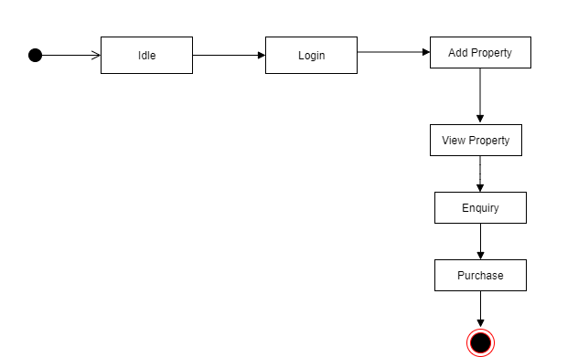
7STATE DIAGRAM

Slide 23
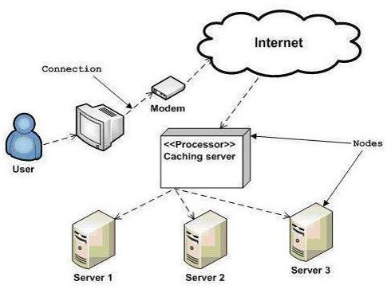
8 DEPLOYMENT DIAGRAM

Slide 24
CONCLUSION
Real Estate Management System – is an Estate Agent and Property Management System is a user friendly contact and property manager for real estate professionals.
It is used for Brokers to add properties, search properties in type wise and city wise , Enquiry about the properties.
Admin is the controller of this system
He can add and update property type, country, state, city.
He also can view the details of owners, brokers, users.
This system is used for reducing the time consumption, money consumption.
We can compare the rate of similar properties in same place.

Slide 25
It is very useful for the real estate field.

